Slide 1

Evaluation and Implementation of a Motivational Bot to support Documentation process in Mechatronics system design
Bhargavi Mohan
Paderborn | 11.06.2021
Notes:
Hello everyone,
I am Bhargavi Mohan. Today I wil be presenting my master thesis topic that is - Evaluation and Implementation of a motivational bot to suppport the documentation of mechatronics system design.
This topic is about the challenges in the feild of mechatronics, the significance of decision making process and the need to document the decisions. It also about how collaboration tools play a crucial role in a cross-disciplinary team and therefore how software bots can be realized as means of motivation to reduce the potential challenges. The core of this master thesis is to provide the members of mechtronics a motivation to document their important decisions discussed over collaboration tools and that motivational factor is brought about by a software bot that helps users to facilitate the documentation process in mechatronics.

Slide 2



Agenda
Motivation
Fundamentals
Evaluation of existing bots
Design and Development
Verification and Validation
Conclusions
Demonstration
Notes:
The agenda is very simple. Firstly, let us very briefly walk through the prerequisites that are essential for further understanding. Secondly, I will explain the motivation behind the implementation of this thesis. Third, I will describe the research approach and it's inference. Next, I will present the design and development of a motivational bot followed by it's verification and validation. In the end, you will see a demonstration of the software prototype.

Slide 3
Motivation
Notes:
So, let us first understand the problem description and the solution idea to tackle the existing problem

Slide 4
Challenges in a multi-disciplinary team
Poor knowledge management due to wide range of disciplines and stakeholders
Exchange of knowledge with respect to terminologies, functional requirements, design parameters and developmental processes
Affects documentation process
Inadequate documentation could impact the design, development and maintenance of the products
A study says documentation of architectural decisions in the industry is usually neglected
A document of design decisions is beneficial for juniors or new team members
The focus of this topic is to motivate the multi-disciplinary team members to document design decisions for their future references
Notes:
Mechatronics being a diverse team raises certain concerns in the course of product development life cycle. The knowledge gap among the different teams can lead to
confusions within team members and hamper the design and development process. The designers, developers and other stakeholders would need the right amount of knowledge transfer across different domains to deliver successful products and systems. Another salient challenge is the lack of care for explicit documentation. Documentation and knowledge exchage are interrelated . Poor documentation is a consequence of poor knowledge management and vice versa.
Having known the importance of decisions specially design decisions, it is equally important to document those design decisions for future reference or for the sake of knowlege transfer activity among different teams.

Slide 5
Collaboration tools are mandatory for co-ordination
Collaboration tools such as MS Teams and Slack aid information exchange
Ideas, decisions, queries, solutions are discussed in group chats
Meant for sharing quick responses, thus contain huge amounts of concise messages
Will have both valuable and valueless information
Difficult to distinguish between significant and insignificant messages
Significant design decisions could be enclosed within lengthy conversations
Incomprehensible for later references due to lack of structure
Design decision information on collaboration tools are worthy to be documented
Notes:
Mechatronics being a diverse team raises certain concerns in the course of product development life cycle. The knowledge gap among the different teams can lead to
confusions within team members and hamper the design and development process. The designers, developers and other stakeholders would need the right amount of knowledge transfer across different domains to deliver successful products and systems. Another salient challenge is the lack of care for explicit documentation. Documentation and knowledge exchage are interrelated . Poor documentation is a consequence of poor knowledge management and vice versa.
Having known the importance of decisions specially design decisions, it is equally important to document those design decisions for future reference or for the sake of knowlege transfer activity among different teams.

Slide 6
Fundamentals
Notes:
So. let's now go through some basic concepts briefly

Slide 7
Fundamentals
Mechatronics
The study of mechatronics systems is an amalgamation of various technological and engineering subjects.
A gateway to massive scientific and technical studies
Decision making process
Comprehensive understanding of decision making procedures in mechatronics is required
Good or bad decisions lead to positive or negative ramifications on systems respectively
Notes:
The 4 chief topics of this thesis are Mechatronics, collaboration tools, decision making process and Software bots. As we all know, mechatronics that dates back to 1960s is a domain that involves multiple technological, engineering disciplines. According to a scientific study, the domain has over 10 technical sub-domains within itself [bri10]. Mechatronic product development means the independent development of mechanical, electrical and software parts that are later united to constitute the entire system. This inter-disciplinary nature of mechatronics is a vital viewpoint because it recognizes the possibility of advanced ideation and conception.
The end product of mechatronics is a system that will poses topnotch performance, accuracy, resilience and other reliable characteritics, To build such a product, complex developmental processes are involved, one of which is the decision making process. The process of a good decision making is valuable in mechatronics because it is the one that decides how other technical processes as well as management processes should be carried out.
In this thesis, the descisions are always considered in the context of design. A design decision should be carefully examined to study its repercussions that it could have on the system later. The design decisions should be made in the appropriate time because, a premature design decision could have serious impacts on system, cost and throughout the entire life cycle.

Slide 8
Fundamentals
Collaboration tools
Supports communication among team members irrespective of geographical locations
Helps reduce friction among team members according to studies
Software bots
Artificial intelligence that provide convenience to carry out daily tasks inside collaboration tools
Smart, reciprocative user interface that can also have the power of automation

Slide 9
Evaluation of existing bots

Slide 10
Requirement characteristics
The bot should be operational within MS teams
Should provide decision templates that are mechatronics-relevant decision terminologies
Should visually distinguish between important design decisions and unimportant messages
Should provide a decision summary
Should offer options to download a copy of the decision summary
Should provide access to metadata
Notes:
The rc goes here

Slide 11
Bot selection strategy
Three bots each from Slack and MS teams were studied
Phrases like “decision”, “documentation”, “summarization”, “motivation” and “message tagging” were used to filter the relevant bots
Bot description of all the bots that showed up were studied
Bots whose features were compliant with the Requirement Characteristics were made eligible for further screening

Slide 12
MS Teams bots
we decide
Decision template with title, description, assigned date, due date
Decision maker either approves/rejects with reasons
Pros- Segregates and accumulates separately
Cons- Independent templates, cannot maintain conversation thread
perfony
Decision templates in the form of folders and sub-folders to maintain thread
Comment sections, attachment sections, bookmark options, download options, archive options
Pros- Conversation thread can be maintained
Cons- Very complex UI design
approve simple
Claimed decision making feature but an approval tool for managers/directors in a 1:1 conversation with the bot
Pros- Displays a queue of all the approvals that needs to be permitted or denied
Cons- Does not handle anything that is required in this thesis

Slide 13
Slack bots
tilda
Chat summarization using /∼addquestion, /∼addanswer , /∼addinfo, /∼addanswer
Message tagged with generalized labels
Pros- The chat summary is available in one place with /∼currentsummary
Cons- Extensive usage of commands to explicitly tag the messages
summarize bot
Summarization of web links
Also summarizes documents, images etc with /summarize [url]
Pros- Allows keyword extraction, key fragments list, desired summary size, downloadable results
Cons- Does not summarize chats
decision bot
Decision template available to fill title, description, decision maker, due date
New channel with the decision title is automatically created to discuss decision related topics
Pros- History, pictorial representation of decisions
Cons- Searching inside new channel is again a difficult task

Slide 14
Evaluation criteria
Evaluation criteria | we decide | perfony | approve simple | tilda | summarize bot | decision bot
Workspace - MS Teams | Yes | Yes | Yes | No | No | No
Message tagging/labeling (VDI specific) | No | No | No | Partially yes | No | No
Design decision management | Yes | Yes | No | Yes | No | Yes
Design decision documentation | Yes | Partially yes | No | Partially yes | No | Yes
Design decision knowledge management | No | No | No | Partially yes | No | Partially yes
Easy metadata retrieval | No | No | No | No | No | No

Slide 15
Inference
None of the bots handles all the Requirement Characteristics
A couple of them pass the decision management and decision documentation criteria but do not tag/label messages with respect to V-model design phases
Knowledge management and data retrieval criteria are not addressed by any bot
Decision templates cannot maintain a conversational thread and cannot auto-generate basic details
Therefore, a new bot has to be developed that satisfies all the requirements and enables every evaluation criteria as it’s feature

Slide 16
Design and Development

Slide 17

D3driver
Drives the design decision documentation, hence D3driver
D3 stands for Design Decision Documentation
Gathers design decisions hence the logo symbolizes the collection of the decisions
Presents a summary of design decisions hence the logo also symbolizes the display of the same

Slide 18
Idea and Approach
Design listed evaluation criteria as feature/functionality of D3driver
Designing bot using MS Teams compatible technologies
Designing message tags/labels with respect to V-model decision terminologies
Designing decision templates using card schema in MS Teams
Designing a configurable tab
Designing a button to enable download to local system
Designing a button that redirects to an endpoint to view raw data
Channel Initialization and Decision templates

Slide 19
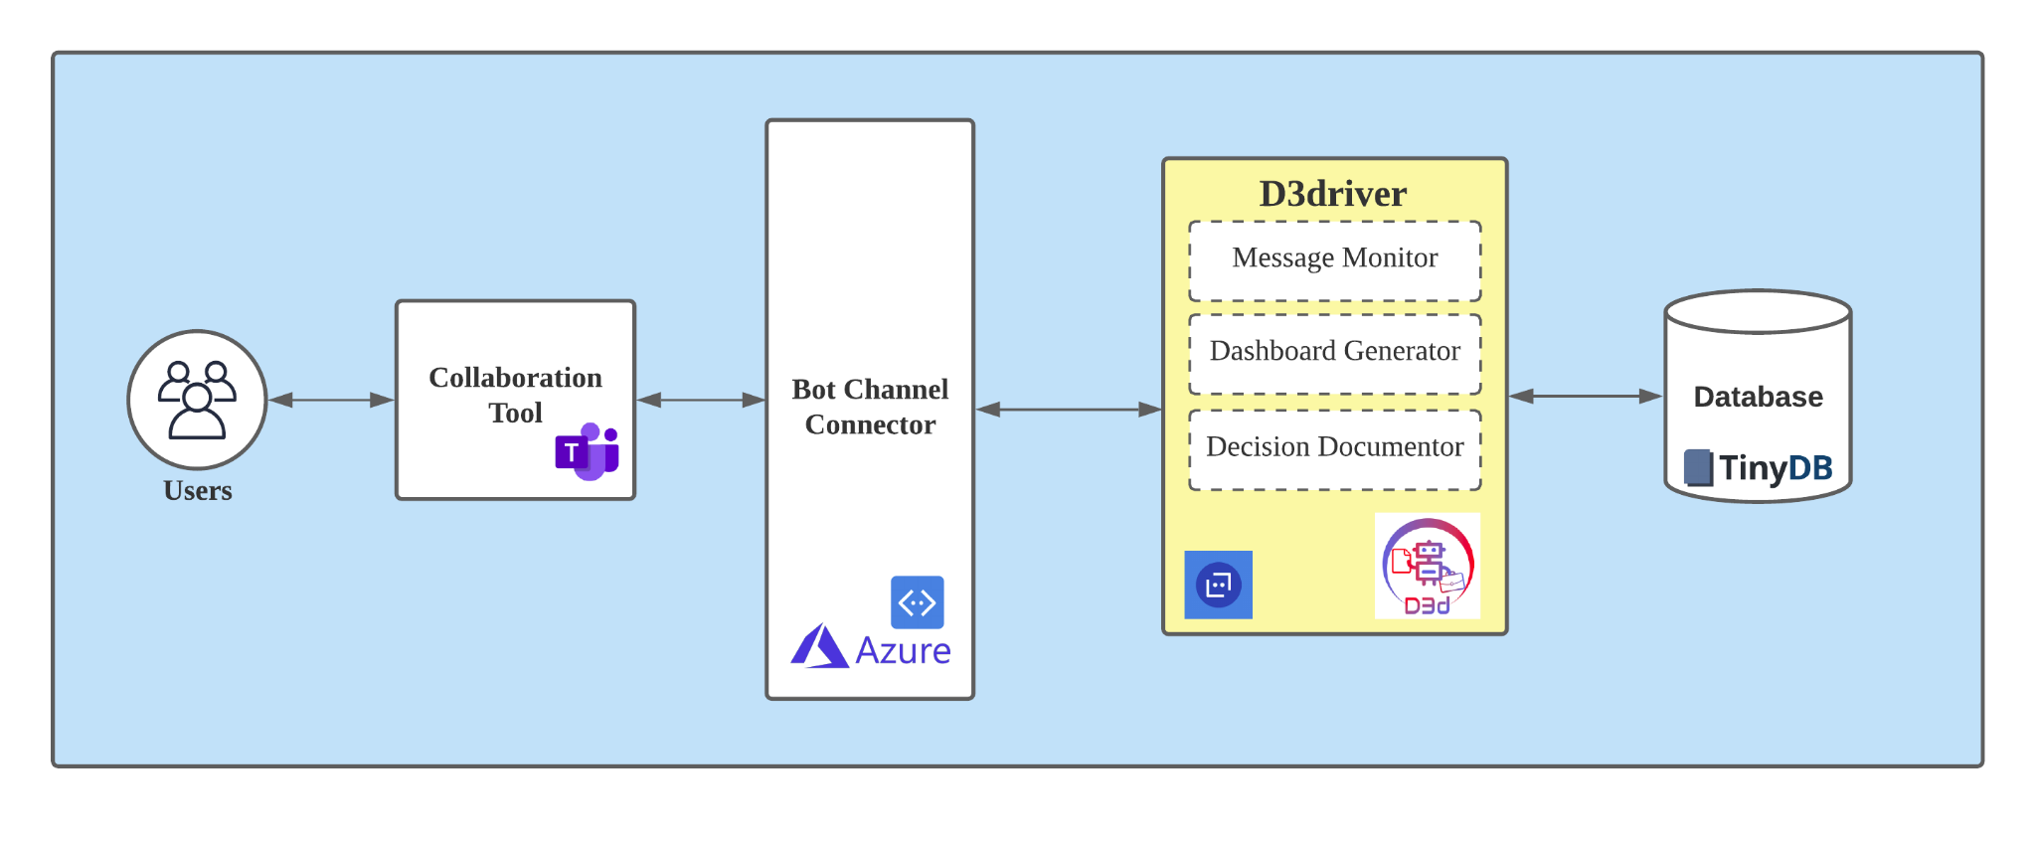
High-level Architecture

Slide 20
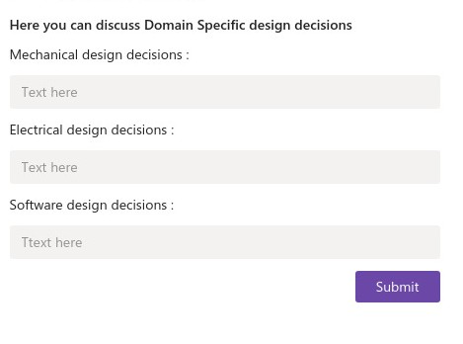
Implementation of D3driver
Bot registration to obtain Bot ID, password and set up desirable configurations
Two main components - D3driver messaging extension and D3driver tab
Three main decision templates implemented as per V-model standards

Slide 21
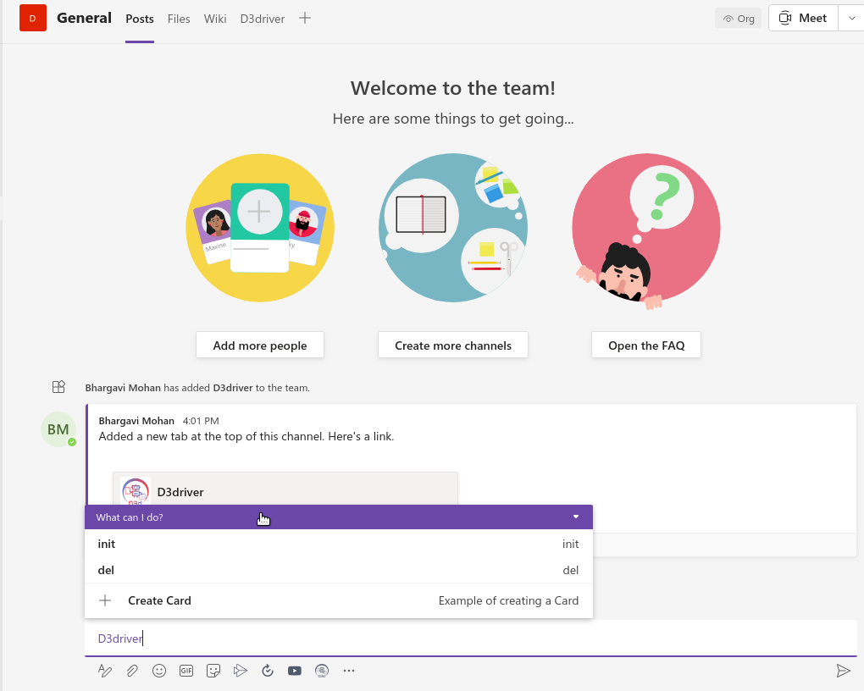
Implementation of D3driver
D3driver tab serves as a dashboard to display a summary of the discussed decisions. Implemented as a web page and is exposed using a tunnel
Two main commands - init, del

Slide 22
Implementation of D3driver
Database contains two tables - Channels table , decisions table
Manifest schema to define how D3driver should be incorporated into MS Teams
Dockerization of D3driver

Slide 23
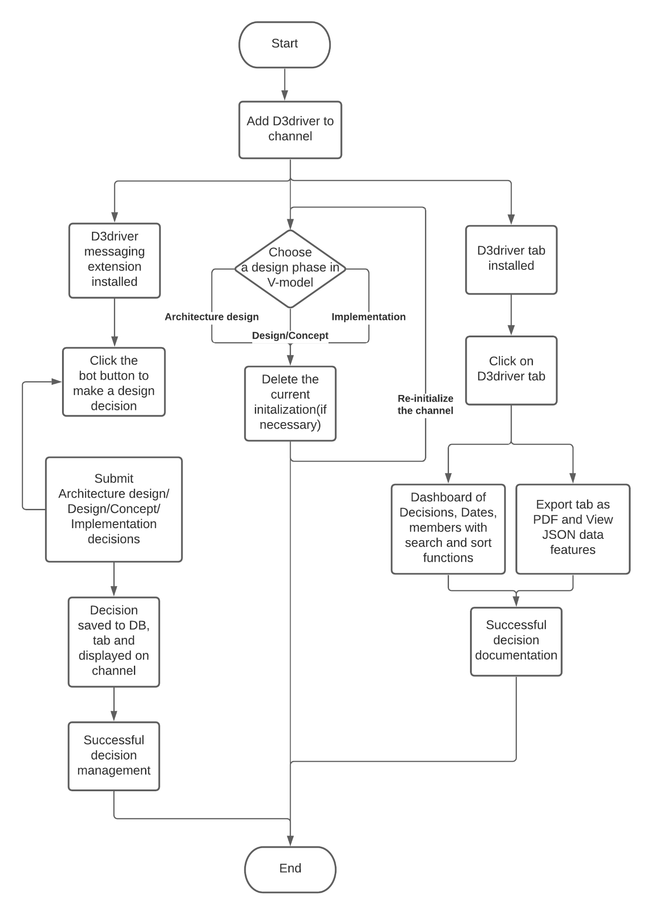
Workflow of D3driver

Slide 24
Technologies
D3driver messaging extension - python
D3driver tab - HTML, CSS, Jinja templating, AIOHTTP
Search, sort, Export as PDF buttons - Javascript
Tunnelling tool - Ngrok
Database - TinyDB (python JSON module)

Slide 25
Verification and Validation

Slide 26
Evaluation criteria - Revisited - Verification
Evaluation criteria | D3driver
Workspace - MS Teams | Operational in MS teams(prototype)
Message tagging/labeling (VDI specific) | Provides decision templates in 3 important V-model design phases
Design decision management | Clearly distinguishes normal conversations from design decisions
Design decision documentation | Offers a separate tab to view discussed design decisions
Design decision knowledge management | Allows members to save a copy of the discussed decisions as PDF
Easy metadata retrieval | A workaround to retrieve raw data as JSON is enabled

Slide 27
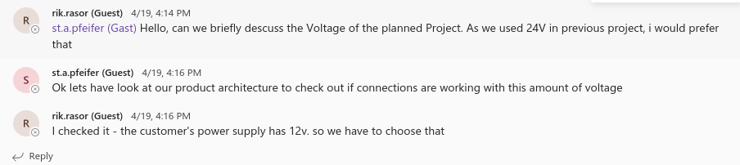
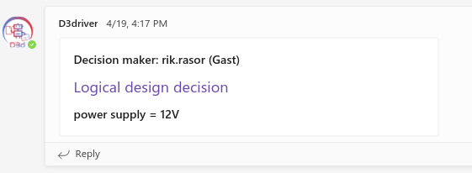
Conversation simulation - Validation
A brief discussion about logical design related to Voltage
Team members choose to document the decision using D3driver

Slide 28
Conclusions and Future work

Slide 29
Conclusions
D3driver has been successful in achieving the goals defined in this thesis
Employed all the listed evaluation criteria as it’s features
Motivates the employees to have a structured documentation of the design decisions
A good documentation in turn promotes effective knowledge transfer activity in mechatronics
Future Enhancements
Introduction of “custom” initialization option
Design of graphs and statistics in the D3driver tab
Implementation of advanced search
Deployment using Microsoft Azure for public use

Slide 30
Thank you!
Notes:
Hello everyone. My name is bhargavi mohan

Slide 31
D3driver demo

Slide 32
Backup slides

Slide 33
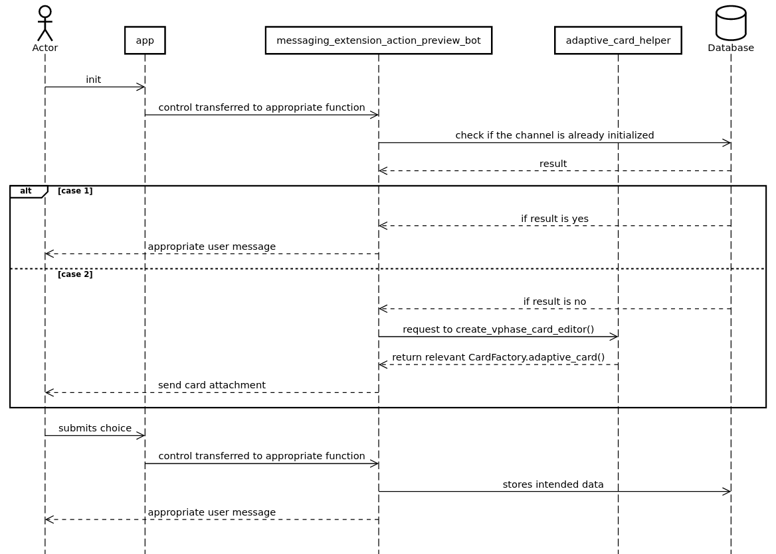
Sequence diagrams - init command

Slide 34
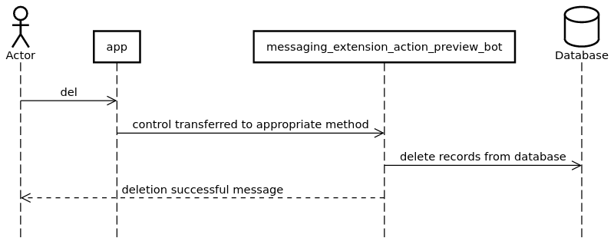
Sequence diagrams - del command

